Slide 1
Nocebo effect and its implications on ethical practice of communicating nuclear waste disposal with SME communities
Kun Wang
kun.wang@manchester.ac.uk

Slide 2
Outline
Research motivation
Aim and objectives development
Overview of the Relevant literature
Proposed future research methods

Slide 3

Nocebo phenomenon: Fears of side effects
Nocebo effects: are adverse effects arise due to factors such as what patient expects, the patient-clinician relationship and other contextual factors (Evers et al, 2021).

Slide 4
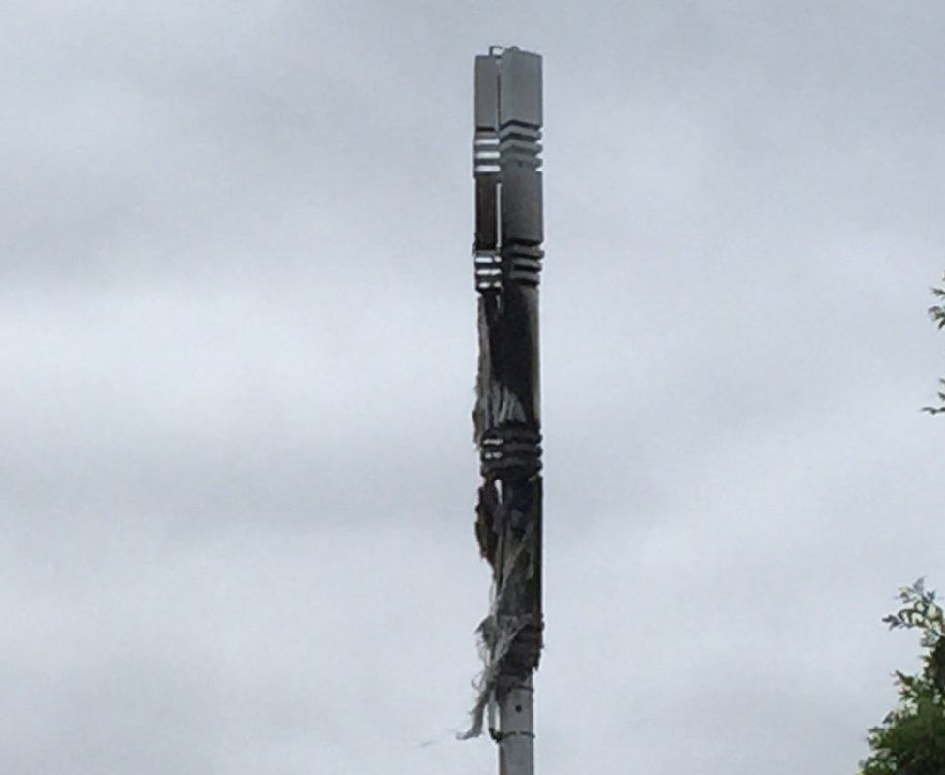

Fears and public behaviours:
Technology and policy is a double-edged sword that can carry people‘s expectations， but at the same time it can also create fear. People are fearful of things they don't understand, which causes a rejection of new technologies that could lead to cost. For example, a popular theory has linked 5G to the spread of COVID-19, leading to misinformation and the burning of 5G towers in the United Kingdom (Ahmed, 2020).
Fear is a frequently occurring attitude that requires considerations by nuclear waste faculties (Greenberg and Truelove, 2011; Perko and Martell, 2021).
BBC (2020)

Slide 5
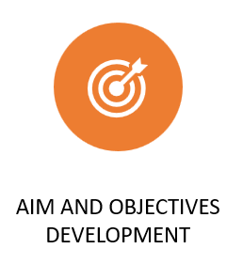
Aim and Objectives:
Aim: to evaluate and reduce the possibilities of causing fears based current information of nuclear waste management delivered to a community.
To categorise the information types related to radioactive waste available to a certain type of community
To investigate the effects of the information on the emotions and reactions of the local communities’ representatives
To develop a framework to mitigate the fears based on the community context
To propose information circulation and ethical communication framework

Slide 6
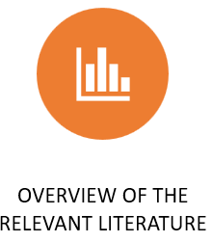
Overview of the literature:
Fear of nuclear has long been discussed and has been considered as a social constructed phenomenon, hence has been discussed with subjective perspectives and factors can impact on the subjective perspectives (Yli-Kauhaluoma & Hänninen, 2014).
Subjective perceptions of risk: Q methodology; survey (e.g. Cho, 2018; Roh & Lee, 2018; Sjöberg, 2003) – what and to what extend the public think about risk
Impact factors: Survey; case studies; social media analysis (e.g Lehtonen, Kojo, et al., 2021; Litmanen, 2016; Qiu et al., 2020) - culture; personal background; how information is presented (framing)

Slide 7
Communication and stakeholder involvement is important for effective, democratic, ethical, and transparent decisions.
Effective public communication:
Roles and involvement;
Media;
Framing strategy (e.g Bowrey, 2020; Perko & Martell, 2021; Rodrigues & Vicente, 2021 )
Though the trust can be enhanced by public communication, acceptance of risk cannot be significantly changed (Qi et al., 2020)
“Risk communication should not only be effective, but also ethical, which requires taking values into consideration and taking decisions in a democratic way” (Perkoa and Martellb, 2021)

Slide 8
Relevant ethical issues concerning placebo and nocebo effects: To tell but not to harm
Even though personal framing is inevitable, patients need to be fully informed about risks and side effects of treatments as well as the possibility of treatment failures)
Disclosures can be made carefully in a manner that does not increase anxiety and simultaneously preventing and reducing nocebo effects (Evers et al., 2021).
Contextualized informed consent: tailoring communication by understanding the needs of patient (Wells & Kaptchuk, 2012)

Slide 9

Research methods:
Case study:
Small-to-Medium Enterprises (SMEs): balance of life and economic concerns business leaders also residents, local labour force and market
Methods rationale:
Understanding the mechanism of nocebo is important for preparing communication (Evers et al., 2021) –
To build cause-and-effect model of information regarding to nuclear wasted distribute to the case communities and fears
Contextualised inform (Wells & Kaptchuk, 2012) –
To review the literature of clinical practice for ethical information crafting methods;
To collect concerns and requirements for information in the case context; To test craft information and add ‘fear mitigators’ for current communication strategy

Slide 10
Bowrey, B. (2020). Nuclear Waste and Society : A Historiographic Review and Analysis of Two Approaches. Intersect, 14(1), 1–16. https://ojs.stanford.edu/ojs/index.php/intersect/article/view/1752
Cho, S. K. (2018). Development of the nuclear safety trust indicator. Nuclear Engineering and Technology, 50(7), 1168–1172. https://doi.org/10.1016/J.NET.2018.07.002
Evers, A. W. M., Colloca, L., Blease, C., Gaab, J., Jensen, K. B., Atlas, L. Y., Beedie, C. J., Benedetti, F., Bingel, U., Büchel, C., Bussemaker, M., Colagiuri, B., Crum, A. J., Finniss, D. G., Geers, A. L., Howick, J., Klinger, R., Meeuwis, S. H., Meissner, K., … Kirsch, I. (2021). What Should Clinicians Tell Patients about Placebo and Nocebo Effects? Practical Considerations Based on Expert Consensus. Psychotherapy and Psychosomatics, 90(1), 49–56. https://doi.org/10.1159/000510738
Lehtonen, M., Kajo, M., Kari, M., Jartti, T., & Litmanen, T. (2021). Trust, mistrust and distrust as blind spots of Social Licence to Operate: illustration via three forerunner countries in nuclear waste management. Journal of Risk Research, 0(0), 1–17. https://doi.org/10.1080/13669877.2021.1957987
Lehtonen, M., Kojo, M., Jartti, T., Litmanen, T., & Kari, M. (2020). The roles of the state and social licence to operate? Lessons from nuclear waste management in Finland, France, and Sweden. Energy Research & Social Science, 61, 101353. https://doi.org/10.1016/J.ERSS.2019.101353
Lehtonen, M., Kojo, M., Kari, M., & Litmanen, T. (2021). Healthy mistrust or complacent confidence? Civic vigilance in the reporting by leading newspapers on nuclear waste disposal in Finland and France. Risk, Hazards and Crisis in Public Policy, 12(2), 130–157. https://doi.org/10.1002/rhc3.12210
Litmanen, T. (2016). Cultural approach to the perception of risk: analysing concern about the siting of a high-level nuclear waste facility in Finland: Https://Doi.Org/10.1177/0734242X9901700307, 17(3), 212–219. https://doi.org/10.1177/0734242X9901700307
Perko, T., & Martell, M. (2021). Communication and stakeholder engagement of microbiology in radioactive waste disposal. The Microbiology of Nuclear Waste Disposal, 291–320. https://doi.org/10.1016/B978-0-12-818695-4.00013-7
Qi, W. H., Qi, M. L., & Ji, Y. M. (2020). The effect path of public communication on public acceptance of nuclear energy. Energy Policy, 144, 111655. https://doi.org/10.1016/J.ENPOL.2020.111655
Qiu, H., Weng, S., & Wu, M. S. (2020). The mediation of news framing between public trust and nuclear risk reactions in post-Fukushima China: A case study. Https://Doi.Org/10.1080/13669877.2020.1749116, 24(2), 167–182. https://doi.org/10.1080/13669877.2020.1749116
Rodrigues1, R. B., & Vicente2, R. (n.d.). New Tools of Public Communication on Radioactive Waste Disposal Projects.
Roh, S., & Lee, J. W. (2018). Differentiated effects of risk perception dimensions on nuclear power acceptance in South Korea. Energy Policy, 122, 727–735. https://doi.org/10.1016/J.ENPOL.2018.05.018
Sjöberg, L. (2003). Attitudes and risk perceptions of stakeholders in a nuclear waste siting issue. Risk Analysis, 23(4), 739–749. https://doi.org/10.1111/1539-6924.00352
Wells, R. E., & Kaptchuk, T. J. (2012). To Tell the Truth, the Whole Truth, May Do Patients Harm: The Problem of the Nocebo Effect for Informed Consent. American Journal of Bioethics, 12(3), 22–29. https://doi.org/10.1080/15265161.2011.652798
Yli-Kauhaluoma, S., & Hänninen, H. (2014). Tale taming radioactive fears: Linking nuclear waste disposal to the “continuum of the good.” Public Understanding of Science, 23(3), 316–330. https://doi.org/10.1177/0963662513503773
Thank you & reference list

