Slide 1

GeoSafe: Towards Safe Geological Disposal of Radioactive Waste in LSSRs
Challenge 3: Mathematical Modelling
Adriana Paluszny (Imperial), Steve Baxter (NWS), Julien Maes (Heriot-Watt), Hannah Menke (Heriot-Watt), Robert Zimmerman (Imperial)
NWS-RSO Annual Conference
Bristol, UK
16th January 2025
1

Slide 2
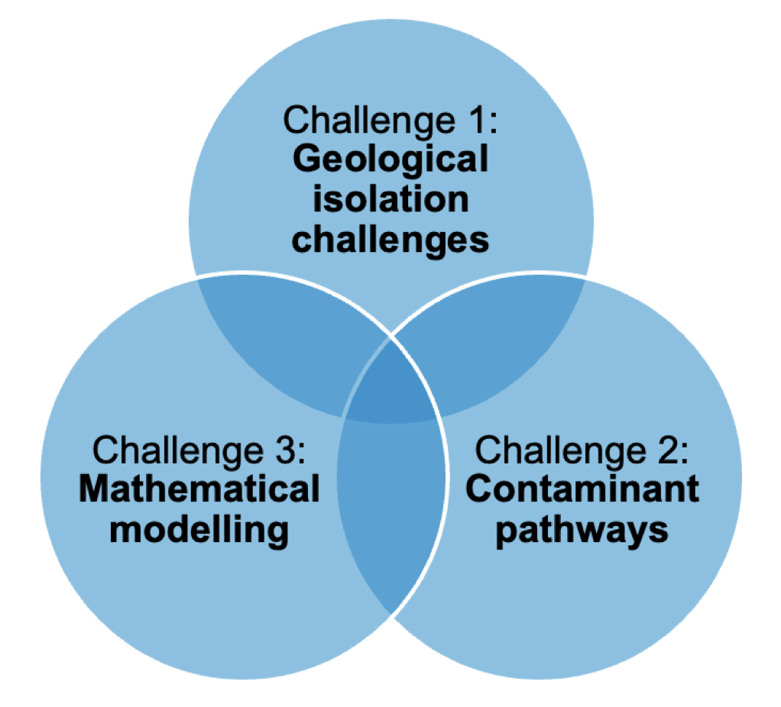
Challenge 3
Develop system-level mathematical models of key sedimentary systems, using the baseline information developed through Challenges 1 and 2.
The developed mathematical models and codes will focus on several key processes that would affect the environment surrounding a GDF, for example:
  Thermal effects from waste and damage caused by excavation process
  Deformation of the host rock and permeability changes
  Deformation processes within the host rock and the overall geochemical evolution of the system
2

Slide 3
Challenge 3
WP 5: Pore-scale reactive transport modelling and upscaling
  (Maes, Heriot-Watt University; + NNL)
WP 6: Modelling of damage caused by excavation process and thermal effects from waste
  (Zimmerman, Imperial)
WP 7: Repository-scale numerical modelling of fluid flow and transport in LSSR rocks
  (Paluszny, Imperial)
3

Slide 4
WP 5:
Pore-scale reactive transport
WP 5: Pore-scale reactive transport modelling and upscaling
In this work package, we are developing a multi-scale numerical framework to model geochemical reactive transport from the nanometre-scale to the centimetre-scale, and will provide quantitative models that describe how fracture permeabilities evolve as a result of radionuclide sorption.
Objectives
  To use numerical simulations and machine learning to upscale radionuclide transport from the nm scale to the mm scale.
  To develop digital twins of mm-scale LSSR samples.
  Use the digital twin geometries to upscale radionuclide transport and sorption from the mm to the cm scale.
  To upscale radionuclide reactive transport and sorption from the cm scale to the reservoir scale.
4

Slide 5
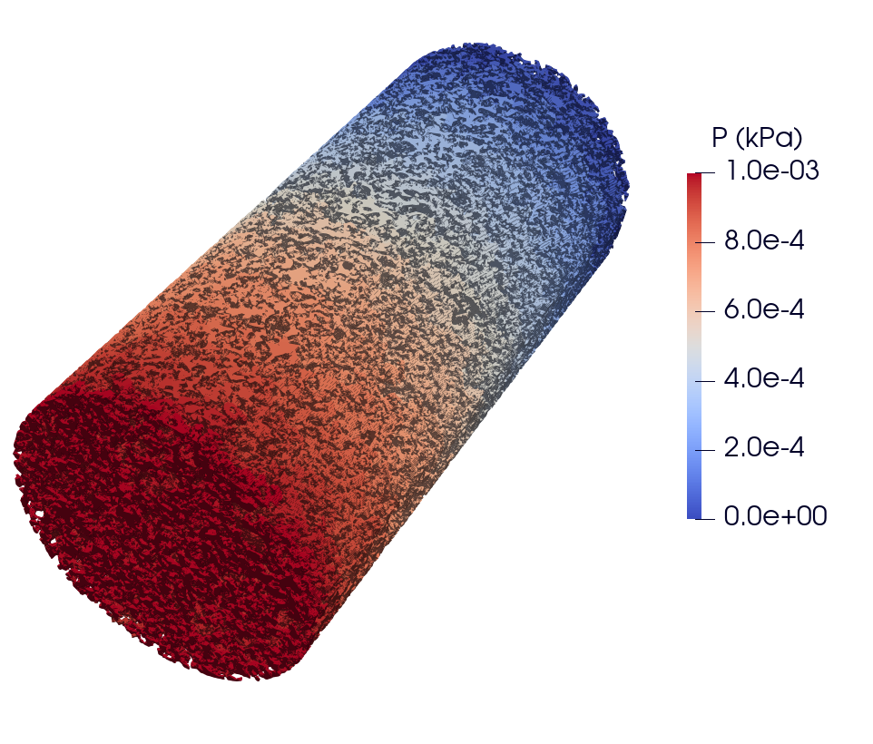
WP 5:
Pore-scale reactive transport
This work package is focused on developing a methodology for simulating and upscaling radionuclide transport and sorption in LSSR rocks, using the in-house GeoChemFoam code, along with the multi-scale 3D and 4D imaging datasets obtained in WP 1 and WP 3.
Work includes the development of a novel HWU mathematical model for calculating dispersivity.
The model is applied to a carbonate rock and a porous hierarchical foam.
Next steps are to add nano-scale dispersion:
Electrokinetics
Nernst-Planck effect
Surface diffusion in electrical double layer
Gibbs-Donnan effect
5

Slide 6
WP 6: Excavation process damage and thermal effects
WP 6: Modelling of damage caused by excavation process and thermal effects from waste
Simulations of the deformation around underground excavations and tunnels in a GDF constructed within LSSR will be conducted using the Imperial College Geomechanics Toolkit (ICGT), making use of rock property values and heterogeneity characterisation from WP1 and WP2. Constitutive modelling of the LSSRs will implement modified Cam-Clay type models, calibrated with data from WP1 and WP2.
Objectives
  To numerically simulate the deformation and damage that will occur around underground excavations and boreholes in a GDF constructed within an LSSR formation, due to the excavation process.
  To compare the damage predictions made using different constitutive models such as Cam-Clay, Drucker-Prager, elastic-brittle, etc.
  To numerically simulate the deformation and damage that will occur around underground excavations and boreholes in a GDF constructed within an LSSR formation, due to thermal effects.
6

Slide 7
WP 6: Excavation process damage and thermal effects
This work package is focused on modelling the non-linear deformation of the host-rock using a robust geomechanical numerical simulator.
The Cam-Clay model has been implemented into the Imperial College Geomechanics Toolkit, and will be calibrated with rock property data from WP1 and WP2.
The model takes into account the definition of a yield surface, which defines the stress conditions under which the rock transitions from elastic to plastic behaviour.
The implementation has been validated against analytical solutions for several types of loading paths.
7

Slide 8
WP 7: Repository-scale fluid flow and transport
WP 7: Transport in LSSR Rocks at the GDF scale
This work package will quantify how subsurface heterogeneities at different scales, as characterised in WP1, affect deformation of the rock or cause damage that may influence the transport of water and gas in the vicinity of the GDF, thereby perhaps permitting the migration of radionuclides. Numerical models will include different potential disposal sites, including the modelling of different rock units, depths, in situ stresses, GDF configurations and deposition scenarios.
Objectives
  Simulation of GDF LSSR base case scenarios of interest, to be selected in collaboration with NWS.
  Identifying GDF, rock properties, and in situ condition variations of interest, as well as large-scale heterogeneities to incorporate into the models.
  Numerically quantify damage development as a function of multi-scale heterogeneities, due to mechanical, fluid-driven, and thermal stresses.
  Simulation of permeability changes in the LSSRs and their effect on transport properties.
  Systematic investigation of LSSR property ranges to develop an understanding of the effects of heterogeneities and in situ conditions on permeability changes during deposition and storage.
8

Slide 9
WP 7: Repository-scale fluid flow and transport
This work package is focused on the simulation of:
  The influence of mechanical and thermal stresses on the LSSR rock,
  The simulation of transport within LSSR formations using detailed FEM simulations and a low-cost particle tracking method, and
  The systematic generation of patterns for a LSSR property ranges to create a geometric parameterisation of the influence of heterogeneity on repository-scale permeability
Thermo-hydro-mechanical ICGT code validations will be generated and submitted for publication
Current work-in-progress includes the definition of the spatial scale of the models to be simulated, the scenarios to model (excavation, deposition, storage), and the types of heterogeneities to be incorporated into the modelling.
9

Slide 10
Challenge 3 also interacts with the two cross cutting themes of the GeoSafe Project:
-Conceptualisation of compositional and physical heterogeneity, and its relation to radionuclide transport
-Fracture/Flow pathways across spatial and temporal scales
GeoSafe Challenge 3: Mathematical Modelling
10

